Slide 1
Chapter 5 Low Noise Amplifiers
5.1 General Considerations
5.2 Problem of Input Matching
5.3 LNA Topologies
5.4 Gain Switching
5.5 Band Switching
5.6 High IP₂ LNAs
5.7 Nonlinearity Calculations
Behzad Razavi, RF Microelectronics.
Prepared by Bo Wen, UCLA

Slide 2
Chapter Outline
Basic LNA Topologies
Alternative LNA
Topologies
Nonlinearity of LNAs
CS Stage with Inductive Load
CS Stage with Resistive Feedback
CG Stage
CS Stage with Inductive Degeneration
Variants of CS LNA
Noise-Cancelling LNAs
Differential LNAs
Nonlinearity Calculations
Differential and Quasi-Differential LNAs

Slide 3
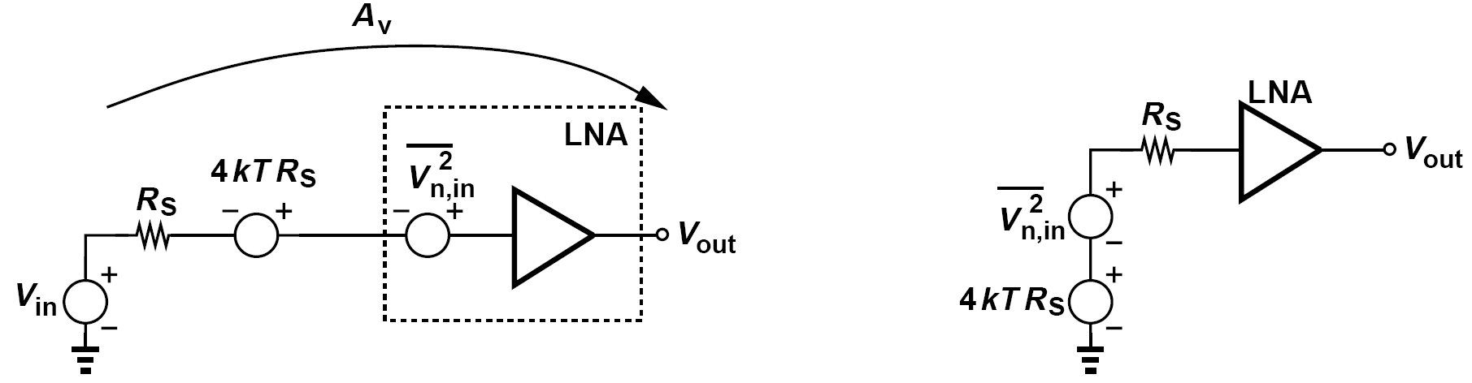
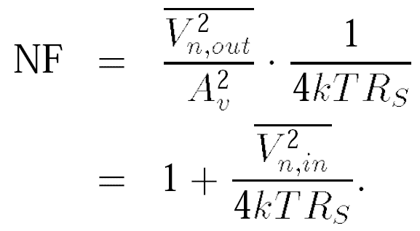
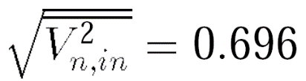
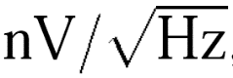
General Considerations: Noise Figure
The noise figure of the LNA directly adds to that of the receiver.
It is expected that the LNA contributes 2 to 3 dB of noise figure. Consider the simple example shown below:
A noise figure of 2 dB with respect to a source impedance of 50Ω translates to:
an extremely low value.

Slide 4
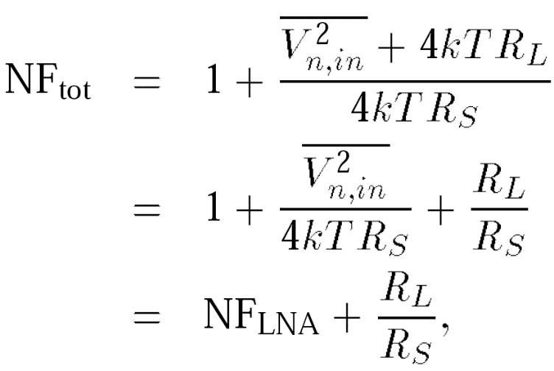
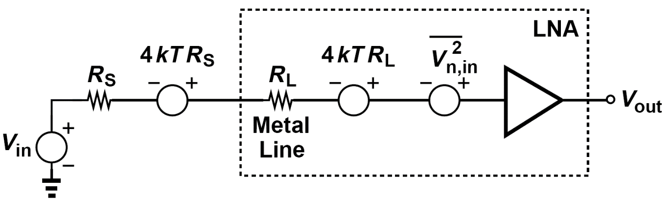
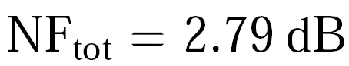
Example of Metal Resistance and Noise Figure
A student lays out an LNA and connects its input to a pad through a metal line 200 μm long. In order to minimize the input capacitance, the student chooses a width of 0.5 μm for the line. Assuming a noise figure of 2 dB for the LNA and a sheet resistance of 40 mΩ/ □ for the metal line, determine the overall noise figure. Neglect the input-referred noise current of the LNA.
We draw the equivalent circuit as shown in figure below, pretending that the line resistance, R_{L}, is part of the LNA. The total input-referred noise voltage of the circuit inside the box is therefore equal to V _{n,in}²+4kTR_{L}. We thus write
where NF_{LNA} denotes the noise figure of the LNA without the line resistance. Since NF_{LNA} = 2 dB ≡ 1.58 and R_{L} = (200/0.5) × 40 mΩ/□ = 16 Ω, we have

Slide 5
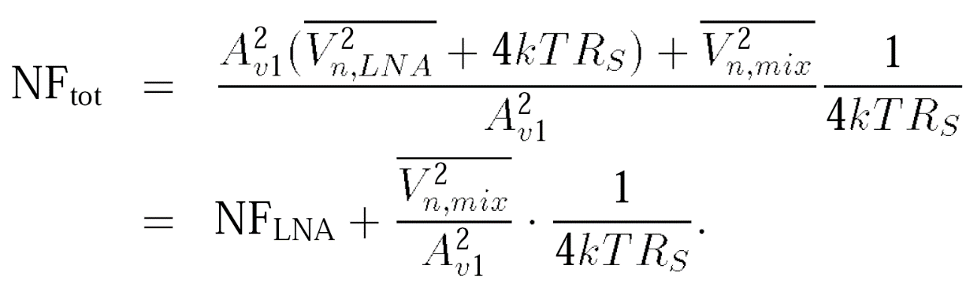
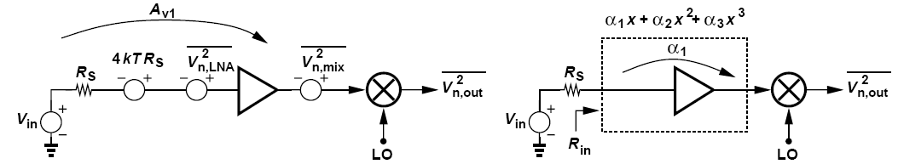
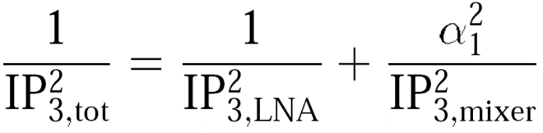
General Considerations: Gain
The gain of the LNA must be large enough to minimize the noise contribution of subsequent stages, specifically, the downconversion mixer(s).
The noise and IP₃ of the stage following the LNA are divided by different LNA gains. Assuming a unity voltage gain for the mixer for simplicity, The overall noise figure is thus equal to
In figure above (right),

Slide 6
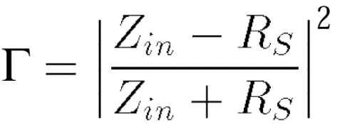
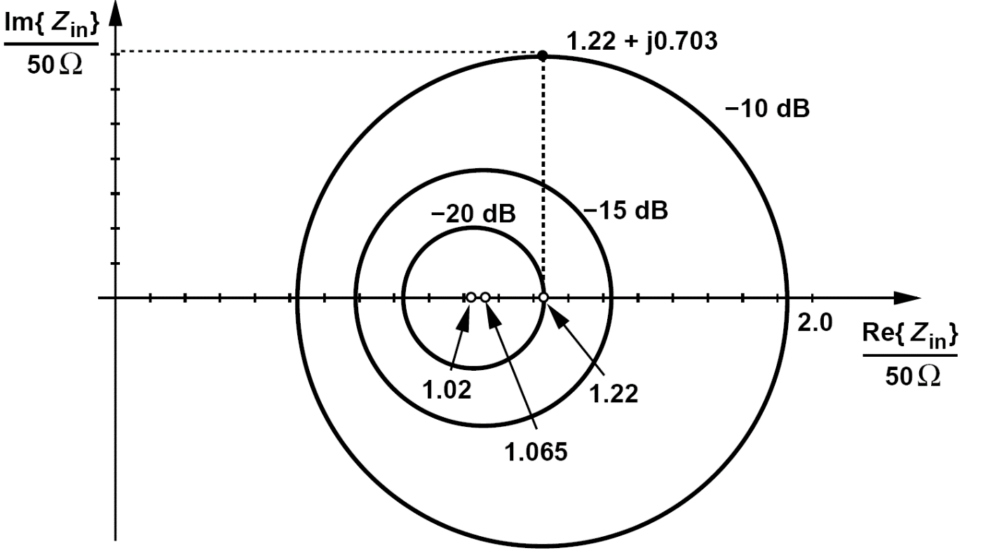
General Considerations: Input Return Loss
The quality of the input match is expressed by the input “return loss,” defined as the reflected power divided by the incident power. For a source impedance of R_{S}, the return loss is given by:
Figure above plots contours of constant Γ in the Z_{in} plane. Each contour is a circle with its center shown.

Slide 7
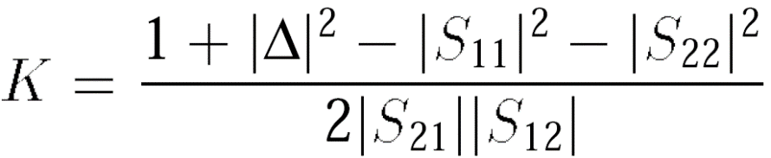
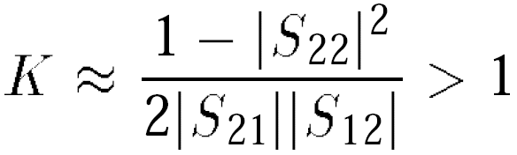
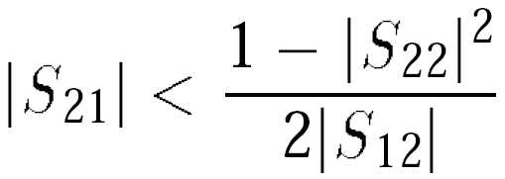
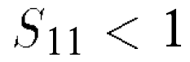
General Considerations: Stability
A parameter often used to characterize the stability of circuits is the “Stern stability factor,” defined as:
A cascade stage exhibits a high reverse isolation, i.e., S₁₂ ≈ 0. If the output impedance is relatively high so that S₂₂ ≈ 1, determine the stability conditions.
With S₁₂ ≈ 0 and S₂₂ ≈ 1,
and hence
In other words, the forward gain must not exceed a certain value. For Δ < 1, we have
concluding that the input resistance must remain positive.

Slide 8
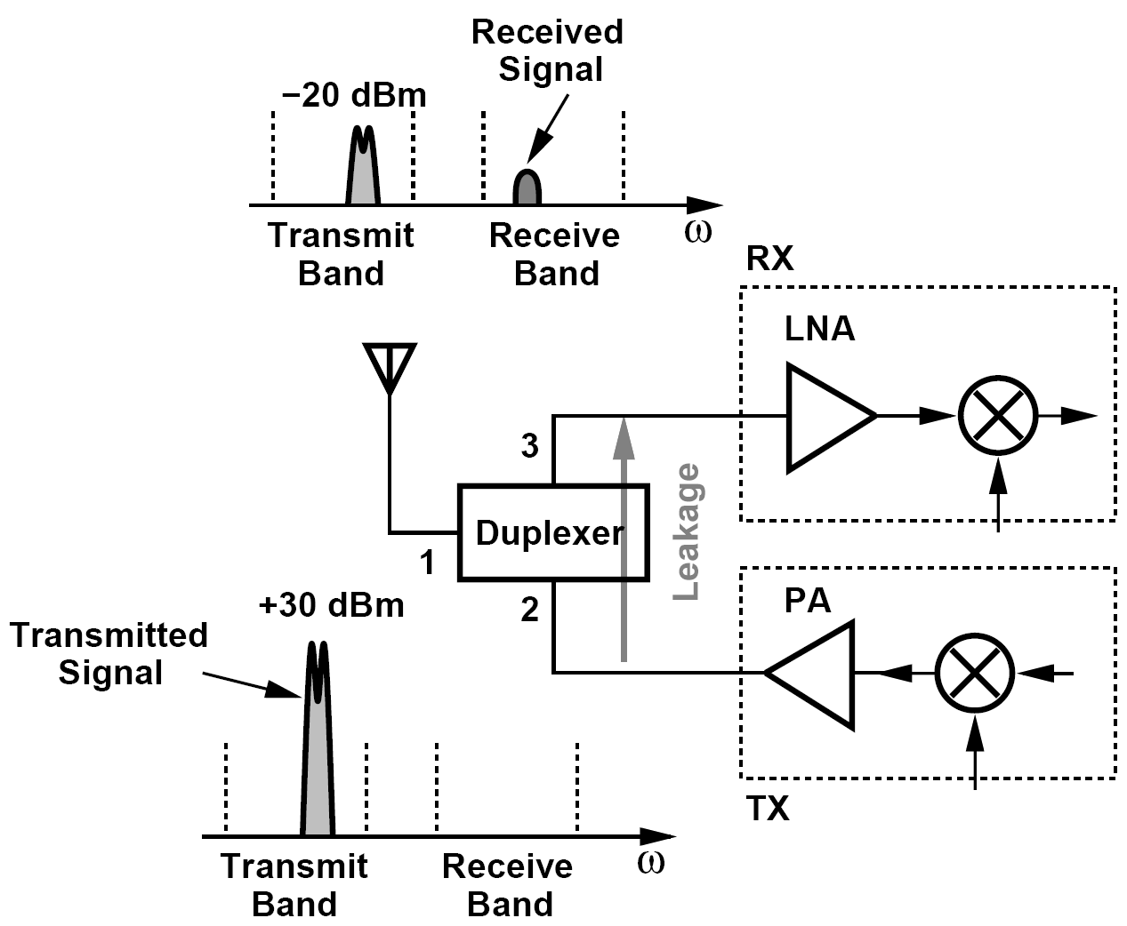
General Considerations: Linearity
In most applications, the LNA does not limit the linearity of the receiver.
An exception to the above rule arises in “full-duplex” systems:
Leakages through the filter and the package yield a finite isolation between ports 2 and 3 as characterized by an S₃₂ of about -50 dB. The received signal may be overwhelmed.

Slide 9
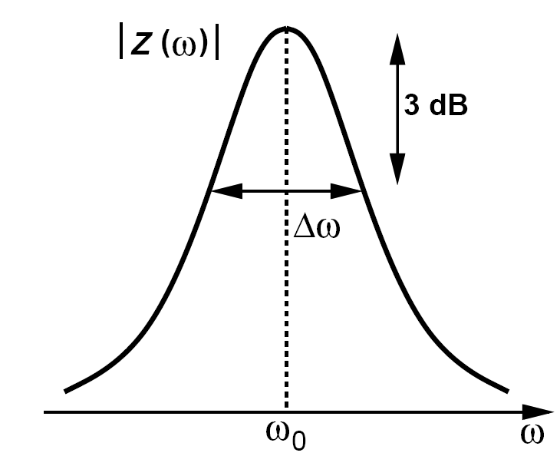
General Considerations: Bandwidth
The LNA must provide a relatively flat response for the frequency range of interest, preferably with less than 1 dB of gain variation. The LNA -3-dB bandwidth must therefore be substantially larger than the actual band so that the roll-off at the edges remains below 1 dB.
An 802.11a LNA must achieve a -3-dB bandwidth from 5 GHz to 6 GHz. If the LNA incorporates a second-order LC tank as its load, what is the maximum allowable tank Q?
As illustrated in figure below, the fractional bandwidth of an LC tank is equal to Δω/ω₀ = 1/Q. Thus, the Q of the tank must remain less than 5.5 GHz/1 GHz = 5.5.

Slide 10
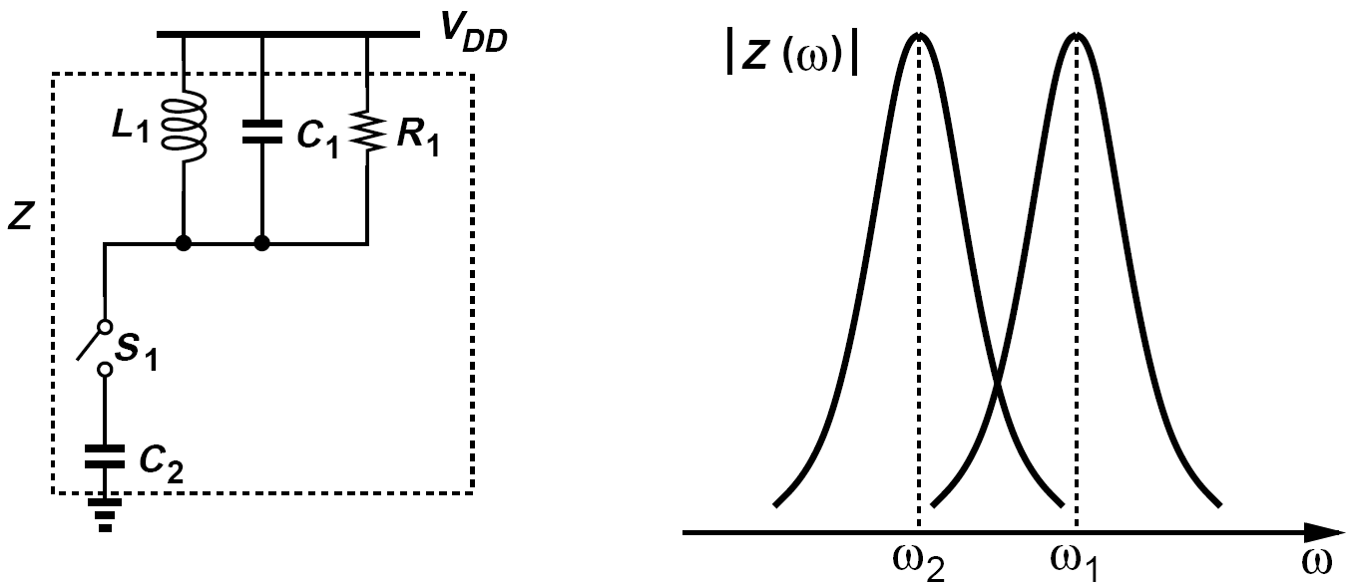
Band Switching
LNA designs that must achieve a relatively large fractional bandwidth may employ a mechanism to switch the center frequency of operation.
As depicted below, an additional capacitor, C₂, can be switched into the tank, thereby changing the center frequency

Slide 11
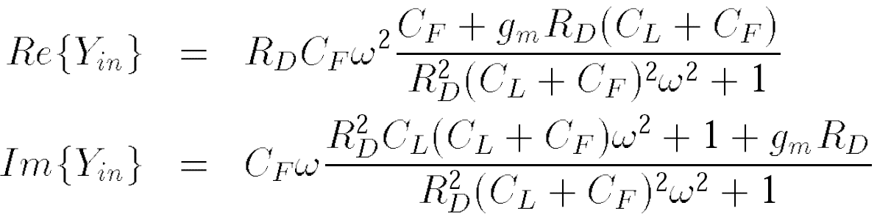
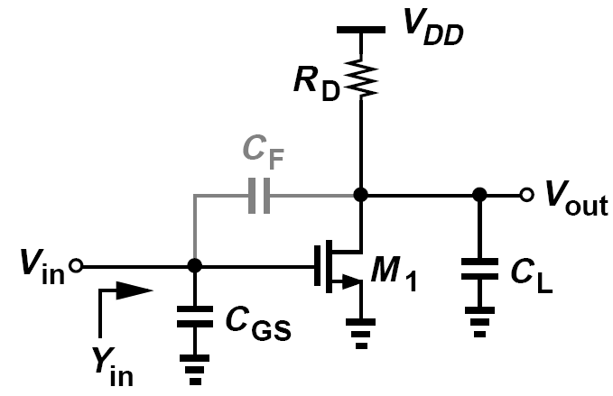
Problem of Input Matching: Input Admittance of a CS Stage
LNAs are typically designed to provide a 50-W input resistance and negligible input reactance. This requirement limits the choice of LNA topologies.
The real and imaginary parts of the input admittance are, respectively, equal to:
Why did we compute the input admittance rather than the input impedance for the circuit of figure above.
The choice of one over that other is somewhat arbitrary. In some circuits, it is simpler to compute Y_{in}. Also, if the input capacitance is cancelled by a parallel inductor, then Im{Y_{in}} is more relevant. Similarly, a series inductor would cancel Im{Z_{in}}. We return to these concepts later in this chapter.

Slide 12
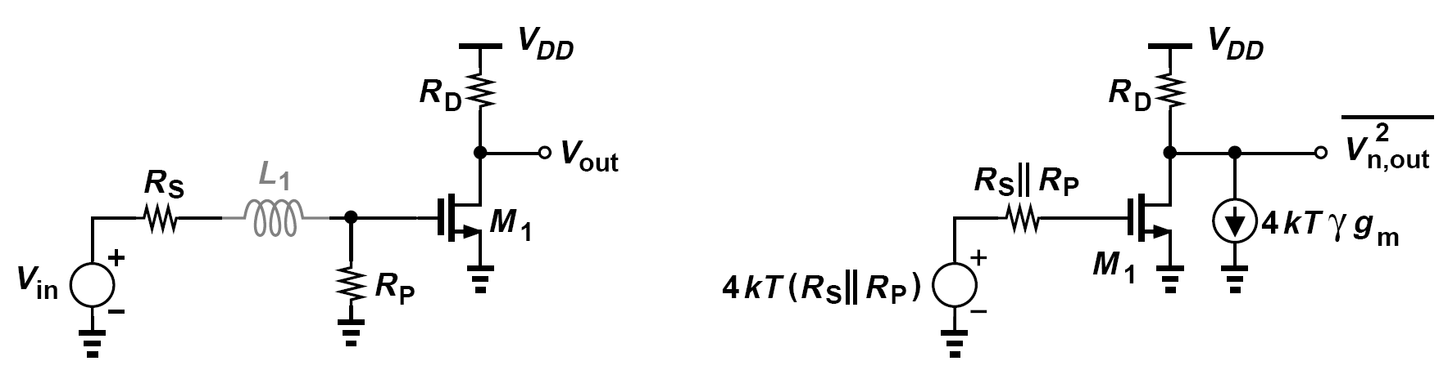
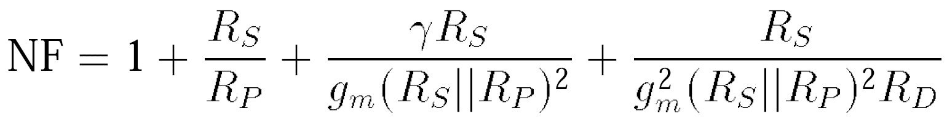
Resistive Termination for Matching
Such a topology is designed in three steps:
(1) M₁ and R_{D} provide the required noise figure and gain
(2) R_{P} is placed in parallel with the input to provide Re{Z_{in}} = 50Ω
(3) an inductor is interposed between R_{S} and the input to cancel Im{Z_{in}}.
express the total output noise as:
the noise figure is given by:

Slide 13
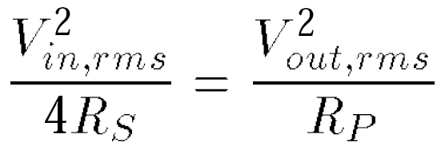
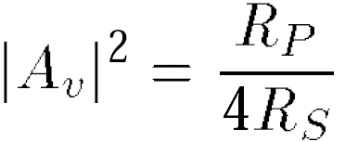
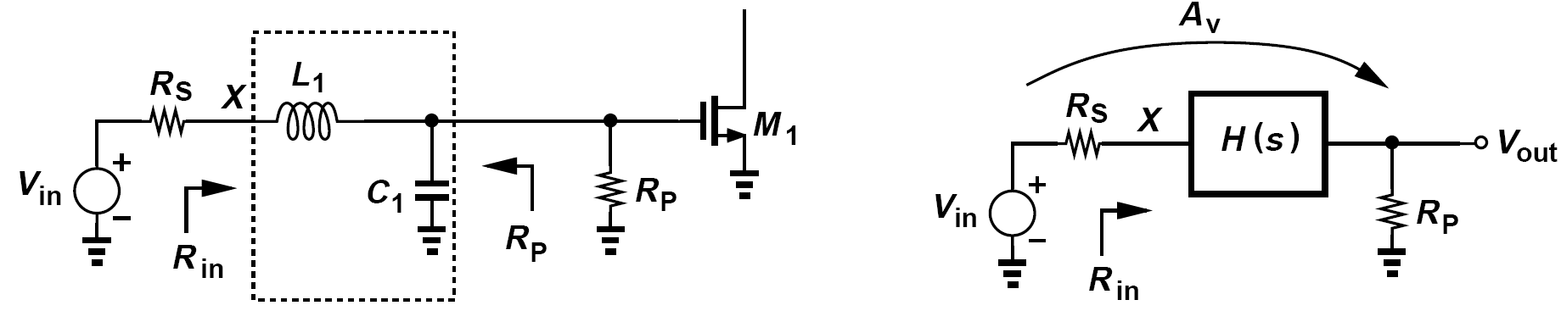
Example of Input Matching by Transforming a Large Resistance Down (Ⅰ)
A student decides to defy the above observation by choosing a large R_{P} and transforming its value down to R_{S}. The resulting circuit is shown below (left), where C₁ represents the input capacitance of M₁. (The input resistance of M₁ is neglected.) Can this topology achieve a noise figure less than 3 dB?
Consider the more general circuit in figure below (right), where H(s) represents a lossless network similar to L₁ and C₁. Since it is desired that Z_{in} = R_{S}, the power delivered by V_{in} to the input port of H(s) is equal to (V_{in,rms}/2)²/R_{S}. This power must also be delivered to R_{P} :
It follows that

Slide 14
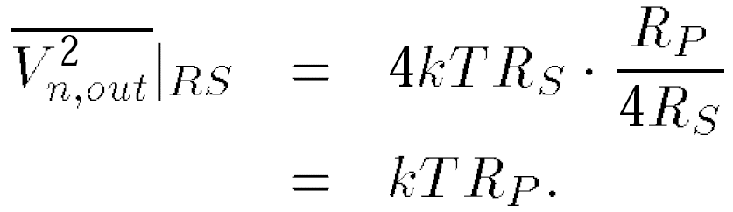
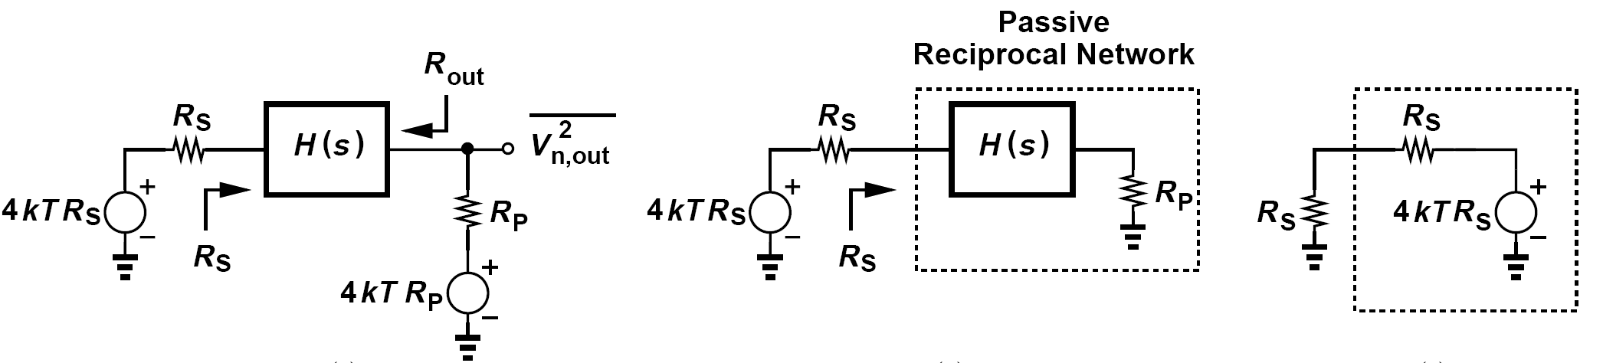
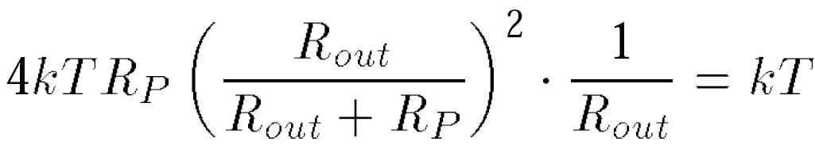
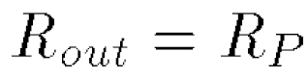
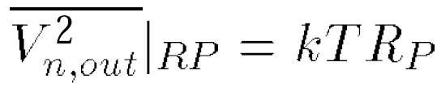
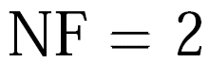
Example of Input Matching by Transforming a Large Resistance Down (Ⅱ)
Let us now compute the output noise with the aid of figure below (left). The output noise due to the noise of R_{S} is readily obtained
How about the noise of R_{P}? We must first determine the value of R_{out}. We draw the circuit as depicted above (middle) and recall that a passive reciprocal network exhibiting a real port impedance of R_{S} also produces a thermal noise of 4kTR_{S}. From the equivalent circuit shown above (right), we note that the noise power delivered to the R_{S} on the left is equal to kT.

Slide 15
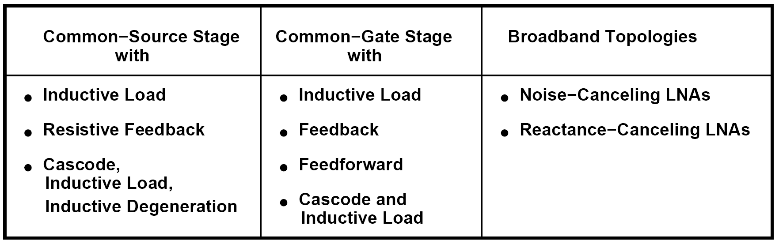
LNA Topologies: Overview
Our preliminary studies thus far suggest that the noise figure, input matching, and gain constitute the principal targets in LNA design. We present a number of LNA topologies and analyze their behavior with respect to these targets.

Slide 16
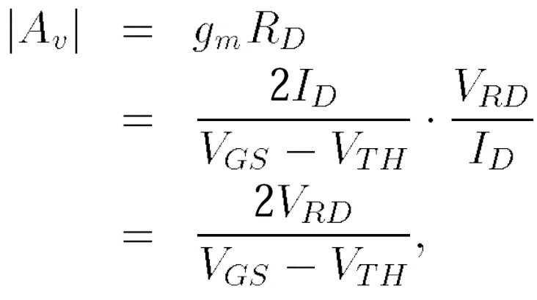
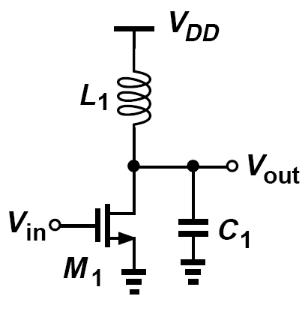
Common-Source Stage with Inductive Load
In general, the trade-off between the voltage gain and the supply voltage in the CS stage with resistive load makes it less attractive as the latter scales down with technology. For example, at low frequencies,
To circumvent the trade-off expressed above and also operate at higher frequencies,
the CS stage can incorporate an inductive load.
Can operate with very low supply voltages
L₁ resonates with the total capacitance at the output node, affording a much higher operation frequency than does the resistively-loaded counterpart

Slide 17
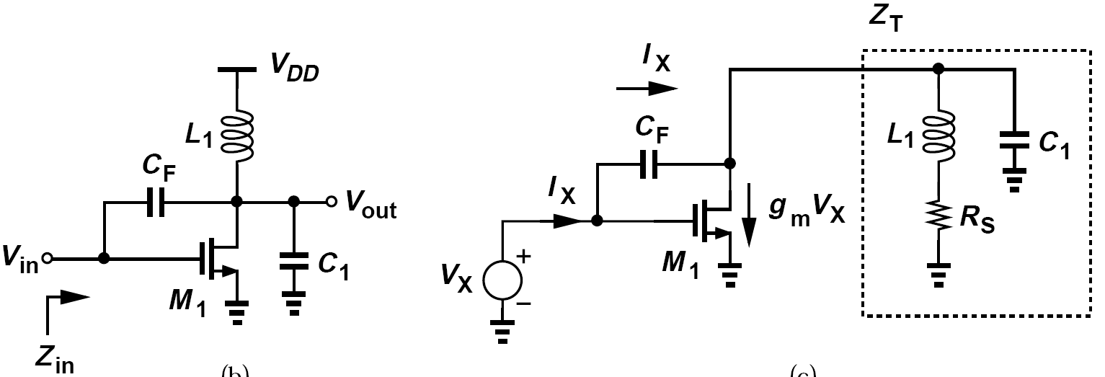
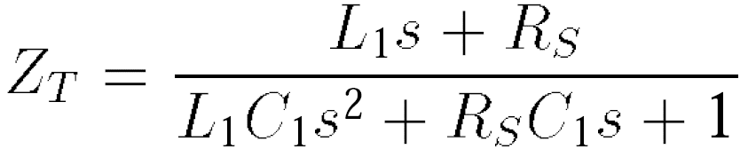
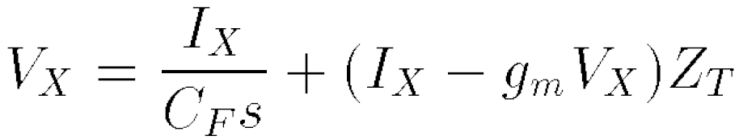
Input Matching of CS Stage with Inductive Load (Ⅰ)
We redraw the circuit as depicted above (right) the inductor loss is modeled by a series resistance, R_{S}, The tank impedance is given by
Adding the voltage drop across C_{F} to the tank voltage, we have

Slide 18
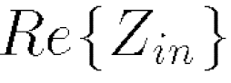
Input Matching of CS Stage with Inductive Load (Ⅱ)
Substitution of Z_{T} gives:
For s = jω:
Since the real part of a complex fraction (a+jb)/(c+jd) is equal to (ac+bd)/(c² +d²), we have
It is thus possible to select the values so as to obtain Re{Z_{in}} = 50Ω

Slide 19
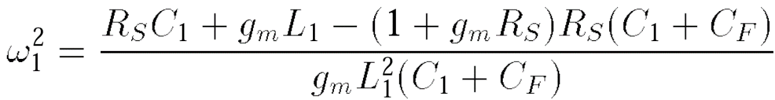
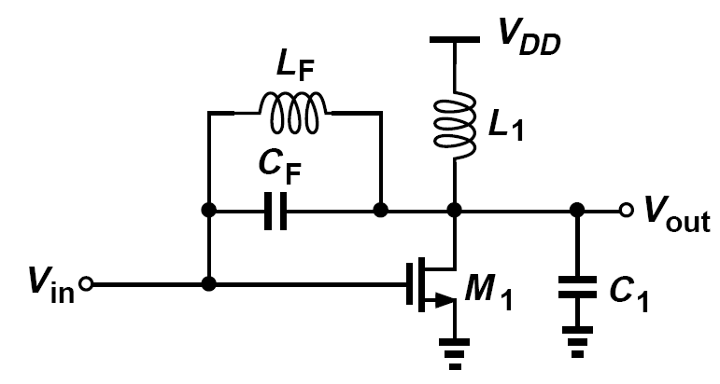
Neutralization of C_{F} by L_{F}
The feedback capacitance gives rise to a negative input resistance at other frequencies, potentially causing instability.
The numerator falls to zero at a frequency given by
Thus, at this frequency (if it exists), Re{Z_{in}} changes sign
It is possible to “neutralize” the effect of C_{F} in some frequency range through the use of parallel resonance.
Will introduce significant parasitic capacitances at the input and output and degrading the performance.
Notes:
通过使用并联谐振，有可能在某些频率范围内 "中和 "CF的影响。
将在输入和输出端引入大量的寄生电容，并使性能下降。

Slide 20
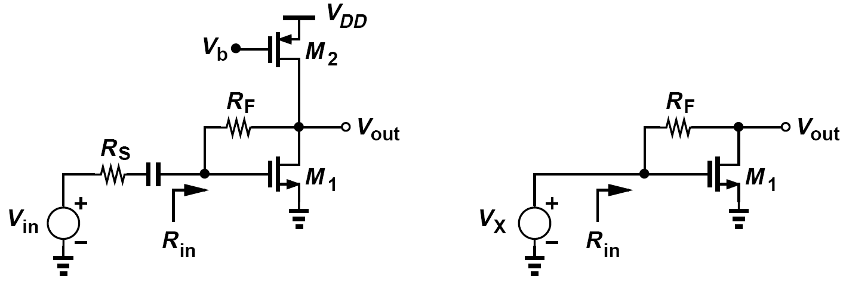
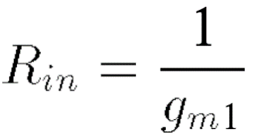
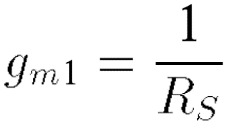
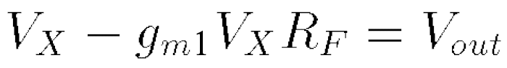
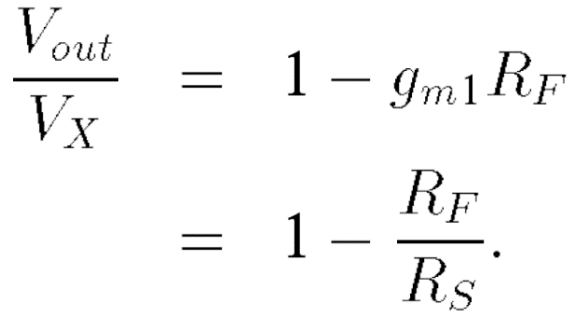
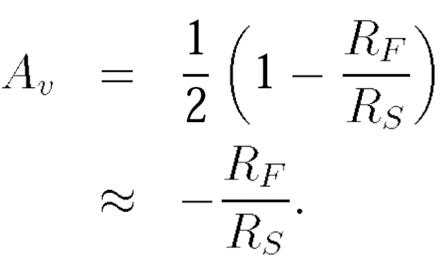
Common-Source Stage with Resistive Feedback
If channel-length modulation is neglected, we have:
输入阻抗 这个模电书上有。
We must choose:
负载和源内阻相等， 匹配网络，放大效果最好。
In figure above (right):
电流* 电阻。 M2 产生的电阻比较大。
Notes:
假设输入电容不是domainate, gm = 1/50 = 0.02 ,在合理的范围内,
增益Av是可控的,

Slide 21
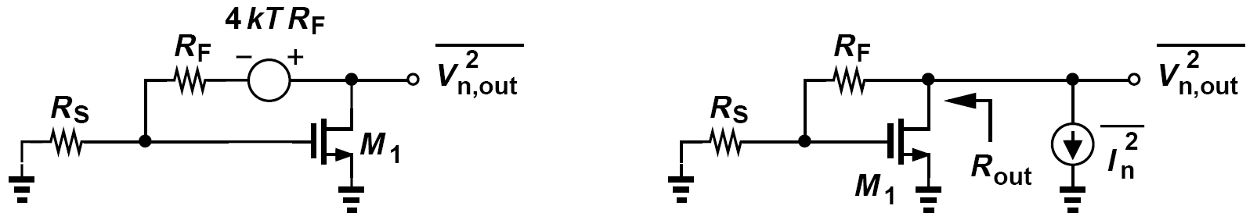
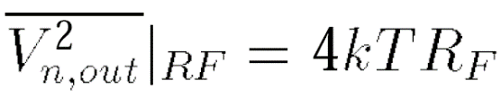
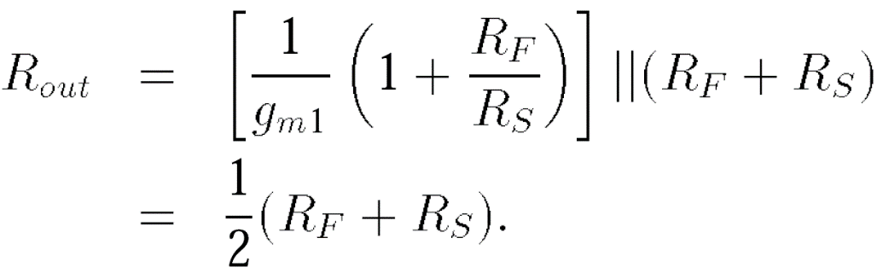


Noise Figure of CS Stage with Resistive Feedback
The noise of RF appears at the output:
Mos管本身也有电阻，
gm1 * Rs =1
Notes:
非常适合先进工艺. 加了个电阻， 4kT Rf。
高频的时候, flick noise也没有了, gm Rs是上面的偏置, 1 是大家都在的, 希望Rf比较大, NF才会小,

Slide 22

Example of NF and Transistor Overdrive Voltages
Express the fourth term on the right-hand side of Noise Figure calculated above in terms of transistor overdrive voltages.
Solution:
Since g_{m} = 2I_{D}/(V_{GS} - V_{TH}), we write g_{m2}R_{S} = g_{m2}/g_{m1} and
That is, the fourth term becomes negligible only if the overdrive of the current source remains much higher than that of M₁—a difficult condition to meet at low supply voltages because |V_{DS2}| = V_{DD} - V_{GS1}. We should also remark that heavily velocity-saturated MOSFETs have a transconductance given by g_{m} = I_{D}/(V_{GS} - V_{TH}) and still satisfy equation above.也就是说，只有当电流源的过驱动一直远高于 M1 时，第四项才可以忽略不计——这是在低电源电压下难以满足的条件，因为 |VDS2| = VDD - VGS1。 我们还应该指出，重度速度饱和的 MOSFET 具有由 gm = ID/(VGS - VTH) 给出的跨导，并且仍然满足上述等式。
Notes:
需要看她的过驱动电压,

Slide 23


Example of CS Stage with Active Load
In the circuit of figure below, the PMOS current source is converted to an “active load,” amplifying the input signal. The idea is that, if M₂ amplifies the input in addition to injecting noise to the output, then the noise figure may be lower. Neglecting channel-length modulation, calculate the noise figure. (Current source I₁ defines the bias current and C₁ establishes an ac ground at the source of M₂).
在下图电路中，PMOS 电流源被转换为“有源负载”，放大输入信号。 这个想法是，如果 M2 除了向输出注入噪声之外还放大输入，那么噪声系数可能会更低。 忽略通道长度调制，计算噪声系数。 （电流源 I1 定义偏置电流，C1 在 M2 的源极处建立交流接地）。
For small-signal operation, M₁ and M₂ appear in parallel, behaving as a single transistor with a transconductance of g_{m1} + g_{m2}. Thus, for input matching, g_{m1} + g_{m2} = 1/R_{S}. The noise figure is still given by previous equation, except that (g_{m1} + g_{m2})R_{S} = γ. That is,
对于小信号操作，M1 和 M2 并联出现，表现为具有 gm1 + gm2 跨导的单个晶体管。 因此，对于输入匹配，gm1 + gm2 = 1/RS。 噪声系数仍然由前面的方程给出，除了 (gm1 + gm2)RS = γ。 那是，
This circuit is therefore superior, but it requires a supply voltage equal to V_{GS1} + |V_{GS2}| + V_{I1}, where V_{I1} denotes the voltage headroom necessary for I₁.
Notes:
经常会采用对称的结构, 电路有电流源, 两个管子可以提供两个有效的gm, 这个放大器就很有优势.

Slide 24




Common-Gate Stage
The low input impedance of the common-gate (CG) stage makes it attractive for LNA design.
The voltage gain from X to the output node at the output resonance frequency is then equal to:
And noise:

Slide 25



Example of Noise in CG Stage with Different Biasing (Ⅰ)
We wish to provide the bias current of the CG stage by a current source or a resistor. Compare the additional noise in these two cases.
For a given V_{b1} and V_{GS1}, the source voltages of M₁ in the two cases are equal and hence V_{DS2} is equal to the voltage drop across R_{B} (=V_{RB}). Operating in saturation, M₂ requires that V_{DS2} ≥ V_{GS2} - V_{TH2}. We express the noise current of M₂ as (M2管子会带来噪声,好处是两个gm)
And that of R_{B} as

Slide 26

Example of Noise in CG Stage with Different Biasing (Ⅱ)
We wish to provide the bias current of the CG stage by a current source or a resistor. Compare the additional noise in these two cases.
Since V_{GS2}-V_{TH2} ≤ V_{RB}, the noise contribution of M₂ is about twice that of R_{B} (for γ ≈ 1). Additionally, M₂ may introduce significant capacitance at the input node.
The use of a resistor is therefore preferable, so long as R_{B} is much greater than R_{S} so that it does not attenuate the input signal. Note that the input capacitance due to M₁ may still be significant. We will return to this issue later. Figure 5.18 shows an example of proper biasing in this case.

Slide 27

Example of Input Impedance of CG Stage
Neglecting the capacitances of M₁ in figure above, plot the input impedance as a function of frequency.
Solution:
At very low or very high frequencies, the tank assumes a low impedance, yielding R_{in} = 1/g_{m} [or 1/(g_{m} + g_{mb}) if body effect is considered]. Figure below depicts the behavior.

Slide 28



More about Channel-Length Modulation
With the strong effect of R₁ on R_{in}, we must equate the actual input resistance to R_{S} to
guarantee input matching:
The voltage gain of the CG stage with a finite r_{O} is expressed as
If r_{O} and R₁ are comparable, then the voltage gain is on the order of g_{m}r_{O}=4, a very low value.
In summary, the input impedance of the CG stage is too low if channel-length modulation is neglected and too high if it is not.
In order to alleviate the above issue, the channel length of the transistor can be increased

Slide 29


Issues of Cascode CG Stage: Noise Contribution of M₂
Neglecting the gate-source capacitance, channel-length modulation, and body effect of M₂, we express the transfer function from V_{n2} to the output at the resonance frequency as
The noise contribution of M₂ is negligible for frequencies up to the zero frequency, (2r_{O1}C_{X})⁻¹, but begins to manifest itself thereafter.

Slide 30




Computation of Gain with C_{GS2}
Assuming 2r_{O1} >> |C_{X}s|⁻¹ at frequencies of interest so that the degeneration impedance in the source of M₂ reduces to C_{X}, recompute the above transfer function while taking C_{GS2} into account. Neglect the effect of r_{O2}.
Writing a KVL in the input loop gives
At frequencies well below the f_{T} of the transistor
That is, the noise of M₂ reaches the output unattenuated if ω is much greater than (2r_{O1}C_{X})⁻¹

Slide 31

Issues of Cascode CG Stage: Voltage Headroom Limitation
The two transistors M₁ and M₂ consume a voltage headroom of one V_{GS} plus one overdrive (V_{GS1} -V_{TH1}).
In order to avoid the noise-headroom trade-off imposed by R_{B}, and also cancel the input capacitance of the circuit, CG stages often employ an inductor for the bias path.

Slide 32



Cascode CS Stage with Inductive Degeneration: Input Impedance
The feedback through the gate-drain capacitance many be exploited to produce the required real part but it also leads to a negative resistance at lower frequencies.
We have: 选择良好的L1和Cgs1 可以抵消虚部.
Since V_{X} = V_{GS1} + V_{P}
Thus, the third term can be chosen equal to 50Ω. 没有电阻但是可以实现实部为电阻
In practice, the degeneration inductor is often realized as a bond wire with the reasoning that the latter is inevitable in packaging and must be incorporated in the design.
Notes:
电感放在M1下面, 就是degeneration退化, 如果这个地方放电阻, 电流分压了增益会变小, 高频的时候L和C会相互抵消, 会变成一个阻抗.

Slide 33



Input Impedance of CS Stage in the Presence of C_{GD}
Determine the input impedance of the circuit shown below (left) if C_{GD} is not neglected and the drain is tied to a load resistance R₁. Assume R₁ ≈ 1/g_{m} (as in a cascode).
Solution:
From equivalent shown here
(right):
Notes:
推导比较复杂, 大作业可以写这个公式

Slide 34




NF Calculation (Ⅰ)
Excluding the effect of channel-length modulation, body effect, C_{GD} and C_{pad} for simplicity
KVL around the input loop yields:
The coefficient of I_{out} represents the transconductance gain of the circuit:
Notes:
这里多了一个LG, 为什么?

Slide 35





NF Calculation (Ⅱ)
Interestingly, the transconductance of the circuit remains independent of L₁, L_{G}, and g_{m} so long as the input is matched
For g_{m}L₁/C_{GS1} = R_{S}
We arrive at the noise figure of the circuit:
It is important to bear in mind that this result holds only at the input resonance frequency and if the input is matched.
Notes:
w0是工作频率, wT是截止频率. 用这种电路可以做到非常低的噪声系数.
重要的是要记住，这个结果只在输入谐振频率和输入匹配的情况下成立。 射频对工艺的要求非常高.

Slide 36




Cascode CS Stage with Inductive Degeneration
Add a cascode transistor in the output branch to suppress the effect of negative resistance.
The voltage gain:
The impedance seen at the source of M₂,
R_{X} rises sharply at the output resonance
frequency.
The voltage gain from the gate to the drain of M₁:
Notes:
这个是重点, 可以认为M2 没有增益, 作为buffer.

Slide 37

Design Procedure (Ⅰ)
The procedure begins with four knowns: the frequency of operation, ω₀, the value of the degeneration inductance, L₁, the input pad capacitance, C_{pad}, and the value of the input series inductance, L_{G}.
Governing the design are the following equations:
In the next step, the dimensions of the cascode device are chosen equal to those of the input transistor.
The design procedure continues with selecting a value for L_{D} such that it resonates at ω₀ with the drain-bulk and drain-gate capacitances of M₂, the input capacitance of the next stage, and the inductors’s own parasitic capacitance.

Slide 38


Design Procedure (Ⅱ)
In the last step of the design, we must examine the input match. Due to the Miller multiplication of C_{GD1} , it is possible that the real and imaginary parts depart from their ideal values, necessitating some adjustment in L_{G}.
Alternatively, the design procedure can begin with known values for NF and L₁ and the following two equations:
The overall LNA appears as shown on right:

Slide 39

Example of Choosing R_{B}
How is the value of R_{B} chosen in figure above?
Since R_{B} appears in parallel with the signal path, its value must be maximized. Is R_{B} = 10R_{S} sufficiently high? As illustrated in figure below, the series combination of R_{S} and L_{G} can be transformed to a parallel combination with R_{P} ≈ Q²R_{S} ≈ (L_{G}ω₀/R_{S})²R_{S}. We note that a voltage gain of, say, 2 at the input requires Q = 3, yielding R_{P} ≈ 450 Ω. Thus, R_{B} = 10R_{S} becomes comparable with R_{P} , raising the noise figure and lowering the voltage gain. R_{B} must remain much greater than R_{P} .
Large resistors may suffer from significant parasitic capacitance. However, increasing the length of a resistor does not load the signal path anymore even though it leads to a larger overall parasitic capacitance.

Slide 40





Comparison Between Input Matching Bandwidth for CG and CS Stage
It is believed that input matching holds across a wider bandwidth for the CG stage than for the inductively degenerated CS stage. Is this statement correct?
For the CS stage (left)
If the center frequency of interest is ω₀
For the CG stage (right), on the other hand:
For ω << ω_{T}

Slide 41

Design Example of Cascode CS LNA (Ⅰ)
Design a cascode CS LNA for a center frequency of 5.5 GHz in 65-nm CMOS technology.
We begin with a degeneration inductance of 1 nH and the same input transistor as that in the CG stage in previous example. Interestingly, with a pad capacitance of 50 fF, the input resistance happens to be around 60Ω. (Without the pad capacitance, Re{Z_{in}} is in the vicinity of 600 Ω.) We thus simply add enough inductance in series with the gate (L_{G} = 12 nH) to null the reactive component at 5.5 GHz.
The design of the cascode device
and the output network is identical
to that of the CG example.

Slide 42

Design Example of Cascode CS LNA (Ⅱ)
Figure below shows the simulated characteristics. We observe that the CS stage has a higher gain, a lower noise figure, and a narrower bandwidth than the CG stage in previous example.
Notes:
一开始增益做大,后面流片会减少,

Slide 43





Variants of Common-Gate LNA: CG LNA with Feedback (Ⅰ)
The block having a gain (or attenuation factor) of α senses the output voltage and subtracts a fraction thereof from the input.
If channel length modulation and body effect are neglected, the closed-loop input impedance is equal to:
At resonance,
To calculate noise figure, we first calculate the gain with the aid of the circuit on the left.

Slide 44




Variants of Common-Gate LNA: CG LNA with Feedback (Ⅱ)
For output noise calculation, we construct the circuit of figure on the right
The NF can be lowered by raising g_{m}
Notes:
这个是这节课的重点, 热噪声gmmma, 要想怎么去除.

Slide 45





CG LNA with Feedforward
The block having a gain (or attenuation factor) of α senses the output voltage and subtracts a fraction thereof from the input.
with the noise of the gain stage A:

Slide 46

CG Stage with Transformer Feedforward
For a coupling factor of k between the primary and the secondary and a turns ratio of n, the transformer provides a voltage gain of kn.
On-chip transformer geometries make it difficult to achieve a voltage gain higher than roughly 3, even with stacked spirals

Slide 47

Noise-Canceling LNAs: Basic Ideas
“Noise-canceling LNAs” aim to cancel the term representing the contribution of the input transistor in the noise figure of LNAs.
First identify two nodes at which the signal appears with opposite polarities but the noise of the input transistor appears with the same polarity.
Then their voltages can be properly scaled and summed such that the signal components add and the noise components cancel.

Slide 48




Noise-Canceling LNAs: Noise Figure
The NF can be lowered by raising g_{m}
We obtain the noise figure as:
Since A₁ = 1 + R_{F}/R_{S}

Slide 49


Noise-Canceling LNAs: Frequency-Dependent NF and Circuit Implementation
It can be proved that the frequency-dependent noise figure is expressed as
where NF(0) is given by equation in previous NF calculation and f₀ = 1/(πR_{S}C_{in})

Slide 50




Example of an Alternative Implementation
Figure below shows an alternative implementation of a noise-canceling LNA that also performs single ended to differential conversion. Neglecting channel-length modulation, determine the condition for noise cancellation and derive the noise figure.
The circuit follows the noise cancellation principle because (a) the noise of M₁, V_{n1}, sees a source follower path to node X and a common-source path to node Y , exhibiting opposite polarities at these two nodes, and (b) the signal sees a common-gate path through X and Y , exhibiting the same polarity. For noise cancellation, we must have
and, since g_{m1} = 1/R_{S}

Slide 51



Reactance-Cancelling LNAs
The idea is to exploit the inductive input impedance of a negative-feedback amplifier so as to cancel the input capacitance, C_{in}.
the input admittance is given by
At frequencies well below ω₀, 1/Re{Y₁} reduces to R_{F} /(1+A₀), which can be set equal to R_{S}, and Im{Y₁} is roughly -A₀ω/(R_{F} ω₀), which can be chosen to cancel C_{in}ω.

Slide 52



Gain Switching in CG Stage
Choose the devices in the above circuit for a gain step of 3 dB.
Solution:
we have
also

Slide 53


LNA Bypass
Receiver designs in which the LNA nonlinearity becomes problematic at high input levels can “bypass” the LNA in very-low-gain modes.
Notes:
LNA 可能要把增益变成负数,如果要更大的动态范围.

Slide 54

Band Switching
LNAs that must operate across a wide bandwidth or in different bands can incorporate band switching.
We prefer the implementation above (right), where S₁ is formed as an NMOS device tied to ground.

Slide 55

Band Switching by Programmable Cascode Branches
An alternative method of band switching incorporates two or more tanks
The principal drawback of this approach is the capacitance contributed by the additional cascode device(s) to node Y .
Also, the spiral inductors have large footprints, making the layout and routing more difficult.

Slide 56

High-IP₂ LNAs: Differential LNAs
Differential LNAs can achieve high IP₂’s because, symmetric circuits produce no even-order distortion.
In principle, any of the single-ended LNAs studied thus far can be converted to differential
form. Shown above are CG (left) and CS (right) stages. 做成差分是解决IP2最简单的方法, 但是电感面积大,

Slide 57

Use of Balun at RX Input
Since the antenna and the preselect filter are typically single-ended, a transformer must precede the LNA to perform single-ended to differential conversion.
The transformer is called a “balun,” an acronym for “balanced-to-unbalanced” conversion because it can also perform differential to single-ended conversion if its two ports are swapped.
Figure above (right) shows the setup for output noise calculation.

Slide 58




Differential CG LNA: Noise Figure
Assuming it is designed such that the impedance seen between each input node and ground is equal to R_{S1}/2
From the symmetry of the circuit that we can compute the output noise of each half circuit and add the output powers:

Slide 59

Comparison of Single-Ended and Differential CG LNAs
Voltage gain of differential CG LNA is twice that of the single ended one. On the other hand, the overall differential circuit contains two R₁’s at its output, each contributing a noise power of 4kTR_{1.}

Slide 60



Example of Differential Version and Noise Figure
An amplifier having a high input impedance employs a parallel resistor at the input to provide matching. Determine the noise figure of the circuit and its diff. version, shown below (middle), where two replicas of the amplifier are used.
Noise figure of the single-ended circuit:
For the differential version:

Slide 61

Differential CS LNA
The differential CS LNA behaves differently from its CG counterpart.
Recall that the input resistance of each half circuit is equal to L₁ω_{T} and must now be halved. This is accomplished by halving L₁.
With input matching and a degeneration inductance of L₁, the voltage gain was found to be R₁/(2L₁ω₀), which is now doubled.

Slide 62



Differential CS LNA: Noise Figure
Neglecting the contribution of the cascode device, if the input is matched, half of the noise current of the input transistor flows from the output node.

Slide 63

Comparison with the Noise Figure of the Original Single-Ended LNA
Compared with the Noise Figure of the Original Single-Ended LNA, both the transistor contribution and the load contribution are halved.
However, this result holds only if the design can employ tow degeneration inductors, each having half the value of that in the single-ended counterpart.

Slide 64

Differential CS Stage with On-Chip Degeneration Inductors
The design can incorporate on-chip degeneration inductors while converting the effect of the (inevitable) bond wire to a common-mode inductance.
The NF advantage implied previously may not materialize in reality because the loss of the balun is not negligible.

Slide 65

Singe-Ended to Differential Conversion
At low to moderate frequencies, V_{X} and V_{Y} are differential and the voltage gain is equal to g_{m1,2}R_{D}.
At high frequencies, however, two effects degrade the balance of the phases: the parasitic capacitance at node P and the gate-drain capacitance of M₁
The capacitance at P can be nulled through the use of a parallel inductor, but the C_{GD1} feedforward persists.

Slide 66


Example of Choice of L_{P}
A student computes C_{P} in previous figure as C_{SB1} + C_{SB2} + C_{GS2}, and selects the value of L_{P} accordingly. Is this an appropriate choice?
Solution:
No, it is not. For L_{P} to null the phase shift at P, it must resonate with only C_{SB1}+C_{SB2}. This point can be seen by examining the voltage division at node P. As shown below, in the absence of C_{SB1} + C_{SB2},
For V_{P} to be exactly equal to half of V_{in} (with zero phase difference), we must have Z₁ = Z₂. Since each impedance is equal to (g_{m} + g_{mb})⁻¹||(C_{GS}s)⁻¹, we conclude that C_{GS2} must not be nulled.

Slide 67

Use of On-Chip Inductors for Resonance and Degeneration
The topology discussed above still does not provide input matching. We must therefore insert (on-chip) inductances in series with the sources of M₁ and M_{2.}
Here, L_{P1} and L_{P2} resonate with C_{P1} and C_{P2}, respectively, and L_{S1}+L_{S2} provides the necessary input resistance.

Slide 68

Balun Issues
External baluns with a low loss (e.g., 0.5 dB) in the gigahertz range are available from manufacturers, but they consume board space and raise the cost.
Integrated baluns, on the other hand, suffer from a relatively high loss and large capacitances.
The resistance and capacitance associated with the spirals and the sub-unity coupling factor make such baluns less attractive.

Slide 69



Use of 1-to-N Balun in an LNA
A student attempts to use a 1-to-N balun with a differential CS stage so as to amplify the input voltage by a factor of N and potentially achieve a lower noise figure. Compute the noise figure in this case.
Since still half of the noise current of each input transistor flows to the output node, the noise power measured at each output is given by
The gain from V_{in} to the differential output is now equal to NR₁/(2L₁ω₀). Doubling the above power, dividing by the square of the gain, and normalizing to 4kTR_{S}, we have
We note, with great distress, that the first two terms have risen by a factor of N²

Slide 70

Realization of Baluns with Non-Unity Turns Ratio
On-chip baluns with a non-unity turns ratio are difficult to design and suffer from a higher loss and a lower coupling factor.
Stacked Spirals Embedded Spirals

Slide 71

Other Methods of IP₂ Improvement
A possible approach to raising the IP₂ entails simply filtering the low-frequency second-order intermodulation product, called the beat component
With this substantial suppression, the IP₂ of the LNA is unlikely to limit the RX performance, calling for techniques that improve the IP₂ of mixers.

Slide 72



Nonlinearity Calculations
Systems with weak static nonlinearity can be approximated by a polynomial such as y = α₁x + α₂x² + α₃x³. Let us devise a method for computing α₁-α₃ for a given circuit. In many circuits, it is difficult to derive y as an explicit function of x. However, we recognize that
It is important to note that in most cases, x = 0 in fact corresponds to the bias point of the circuit with no input perturbation.

Slide 73






Degenerated CS Stage-IP₃ Calculation (Ⅰ)
For a simple square-law device
Since V_{GS} = V_{in} - R_{S}I_{D},
Hence
Also
线性度和
Thus, in the absence of signals

Slide 74





Degenerated CS Stage-IP₃ Calculation (Ⅱ)
We now compute the second derivative
With no signals
Lastly, we determine the third derivative
Which reduces to
To compute the IP₃ of the stage, we write

Slide 75

CS Stage Driven by Finite Signal Source Impedance
A student measures the IP₃ of the CS stage discussed above in the laboratory and obtains a value equal to half of that predicted by above equation. Explain why.
Solution:
The test setup is shown above, where the signal generator produces the required input. The discrepancy arises because the generator contains an internal output resistance R_{G} = 50 Ω, and it assumes that the circuit under test provides input matching, i.e., Z_{in} = 50 Ω. The generator’s display therefore shows A₀/2 for the peak amplitude. The simple CS stage, on the other hand, exhibits a high input impedance, sensing a peak amplitude of A₀ rather than A₀/2. Thus, the level that the student reads is half of that applied to the circuit. This confusion arises in IP₃ measurements because this quantity has been traditionally defined in terms of the available input power.

Slide 76






Example of IP₃ Calculation of a CG Stage
Compute the IP₃ of a common-gate stage if the input is matched. Neglect channel-length modulation and body effect.
Differentiating both sides with respect to V_{in} gives:
In the absence of signals
The second derivative is identical to that of the CS stage
and the third derivative emerges as

Slide 77



Undegenerated CS Stage: IP₃ Calculation (Ⅰ)
The effect of mobility degradation due to both vertical and lateral fields in the channel can be approximated as:
And
Replace V_{GS} with V_{in} + V_{GS0}, obtaining
It follows that

Slide 78



Undegenerated CS Stage: IP₃ Calculation (Ⅱ)
We note that the IP₃ rises with the bias overdrive voltage, reaching a maximum of

Slide 79

Calculation with Another Approximation
If the second term in the denominator of previous approximation of I_{D} is only somewhat less than unity, a better approximation must be used, e.g., (1 + ε)⁻¹ ≈ 1 - ε + ε². Compute α₁ and α₃ with this approximation.
Solution:
The additional term a²(V_{GS} - V_{TH})² is multiplied by K(V_{GS} - V_{TH})², yielding two terms of interest: 4Ka²V_{in}(V_{GS} - V_{TH})³ and 4Ka²V_{in}³(V_{GS} - V_{TH}). The former contributes to α₁ and the latter to α₃. It follows that

